Slide 1
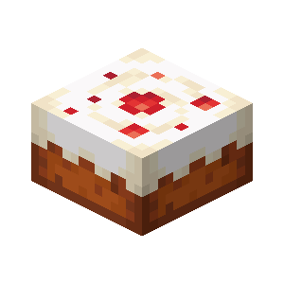
Notes:
cake

Slide 2

Notes:
cookie

Slide 3
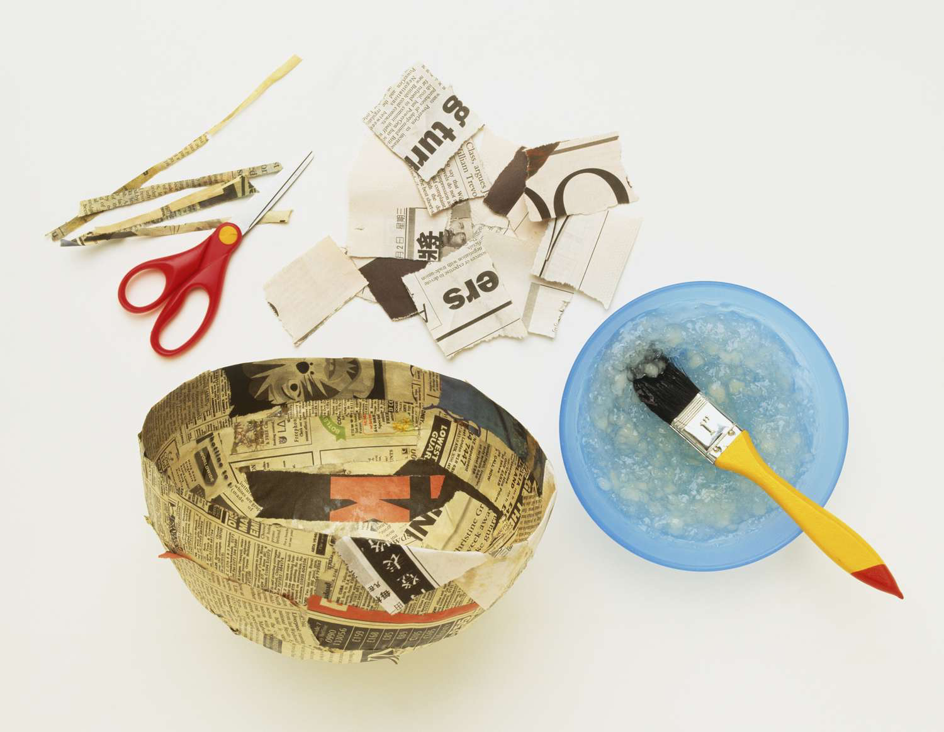
Notes:
Papier mache

Slide 4
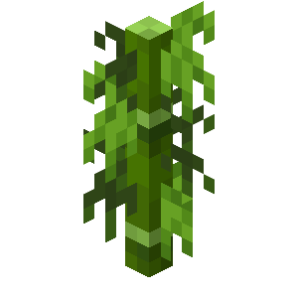
Notes:
bamboo

Slide 5

Notes:
Jennifer Coolidge

Slide 6

Notes:
carrot

Slide 7
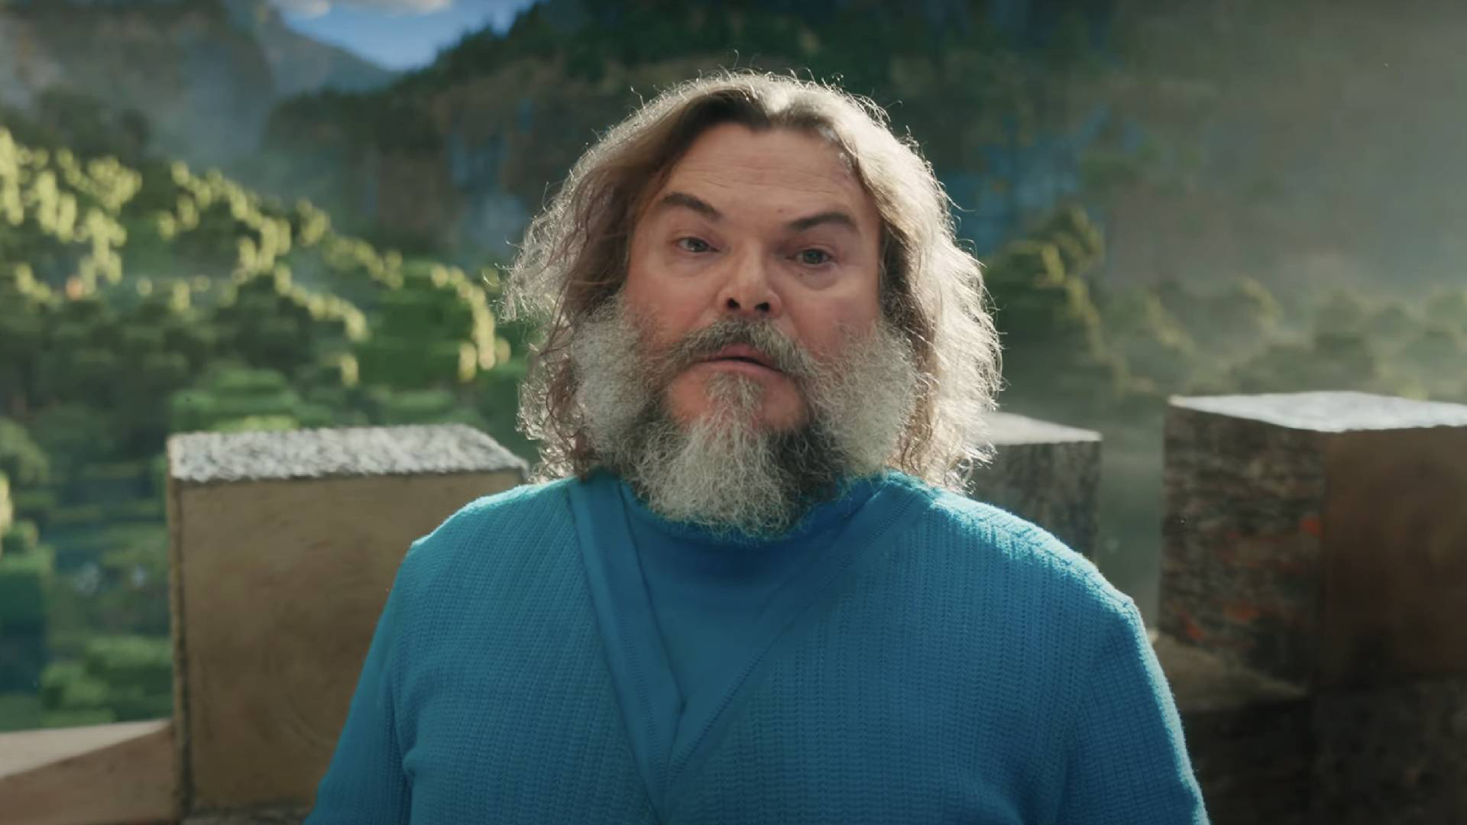
Notes:
Jack Black

Slide 8
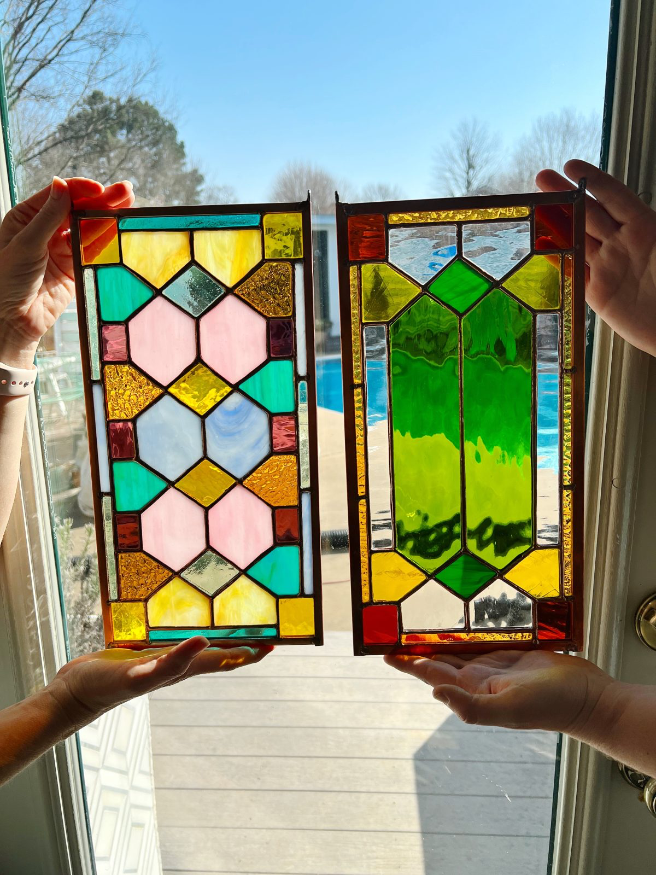
Notes:
Stained glass

Slide 9
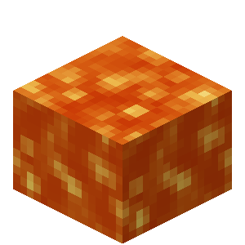
Notes:
lava

Slide 10
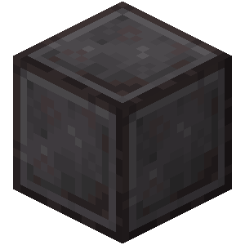
Notes:
Netherite

Slide 11
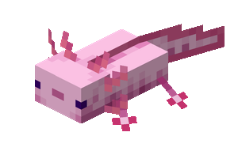
Notes:
axolotl

Slide 12

Notes:
boots

Slide 13
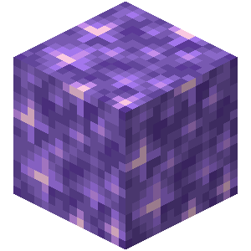
Notes:
amethyst

Slide 14
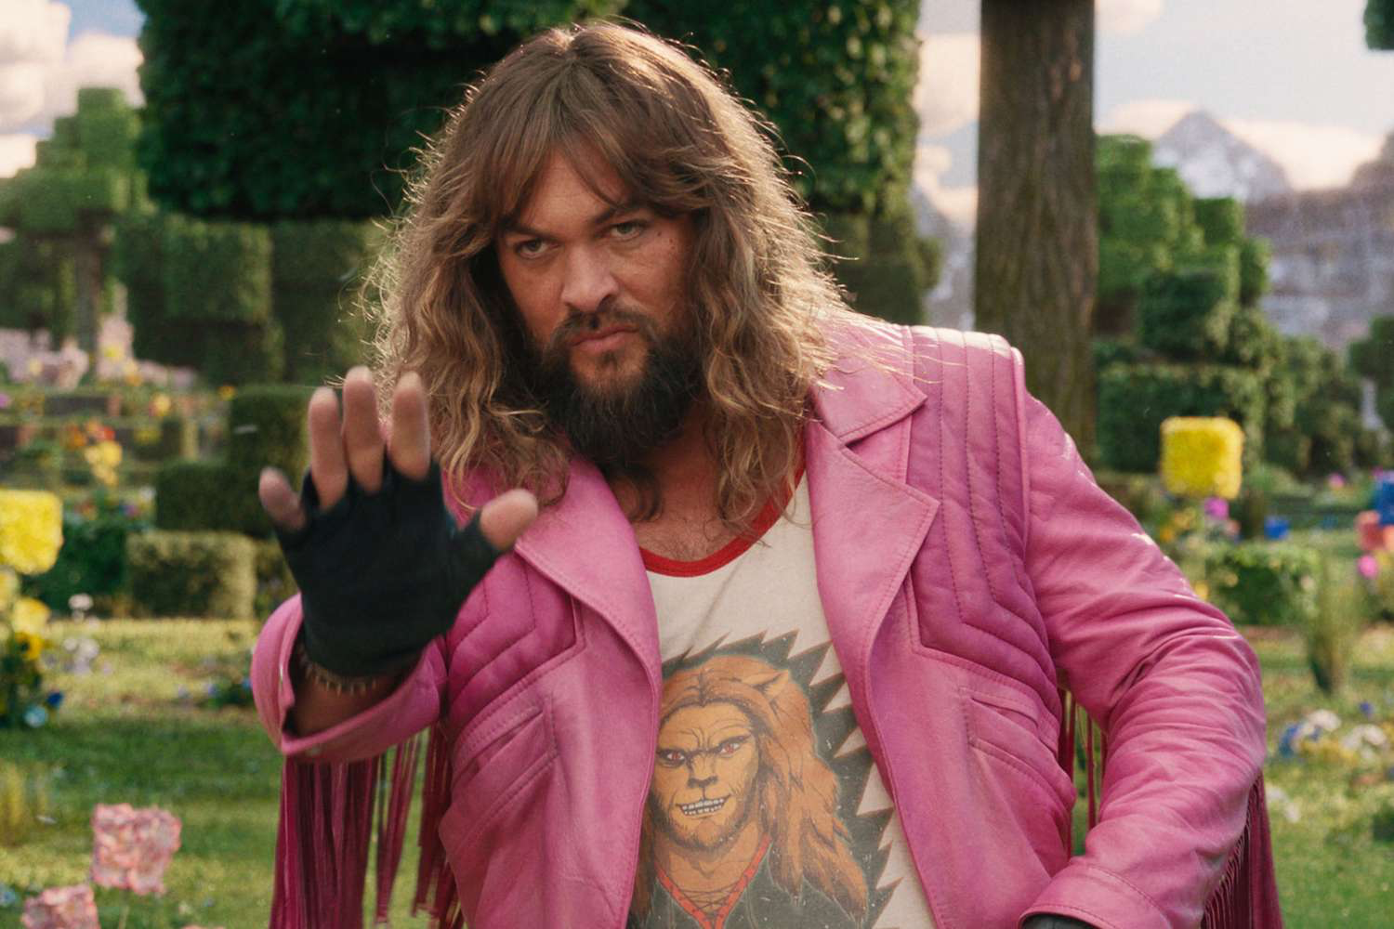
Notes:
Jason Momoa

Slide 15
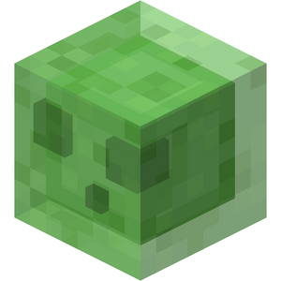
Notes:
slime

Slide 16
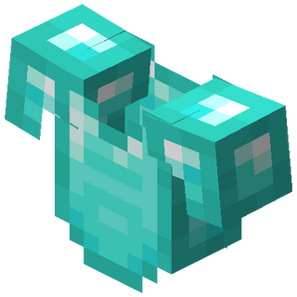
Notes:
chestplate

Slide 17
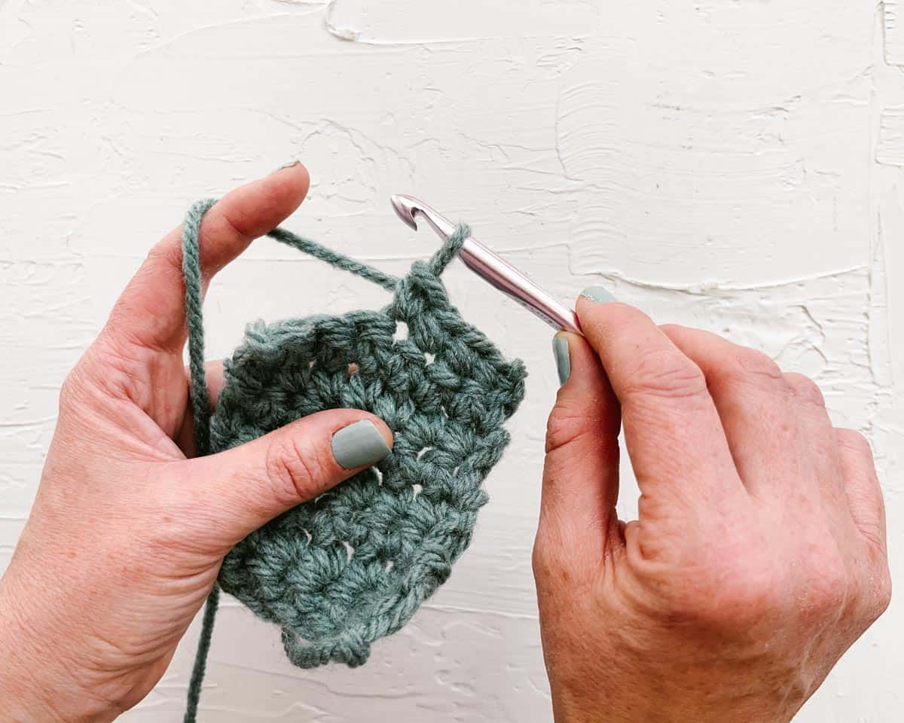
Notes:
crochet

Slide 18
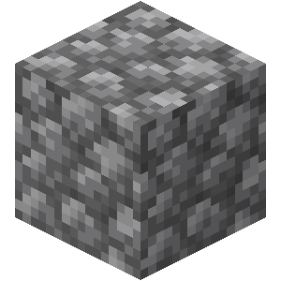
Notes:
cobblestone

Slide 19
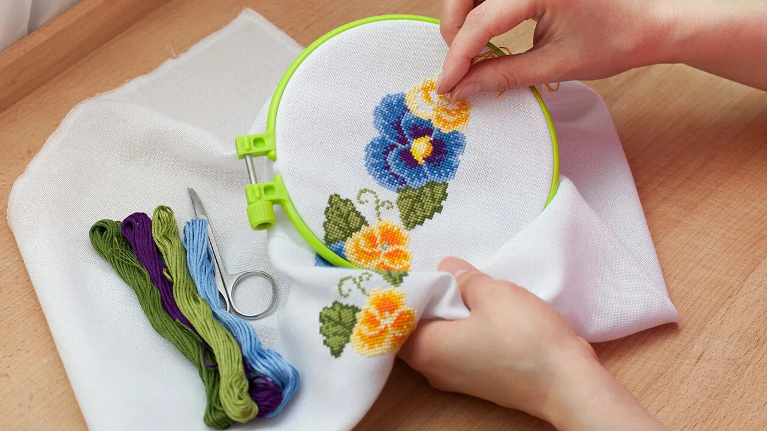
Notes:
embroidery

Slide 20
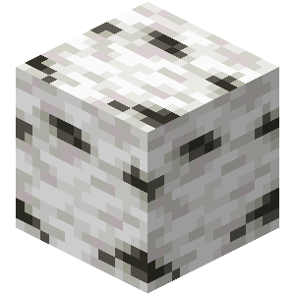
Notes:
Birch wood

Slide 21
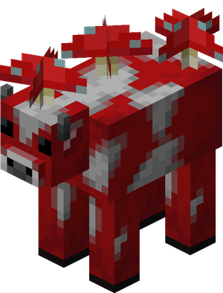
Notes:
Mooshroom

Slide 22
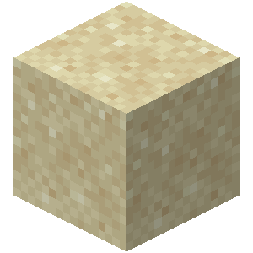
Notes:
sand

Slide 23
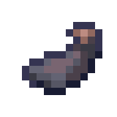
Notes:
Ink sac

Slide 24
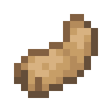
Notes:
Rabbit’s foot

Slide 25
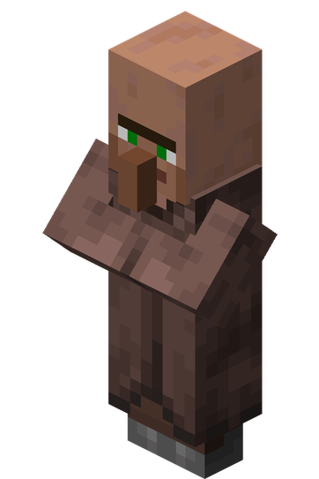
Notes:
villager

Slide 26

Notes:
Water bucket

Slide 27
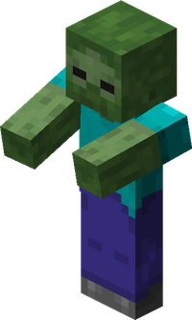
Notes:
zombie

Slide 28
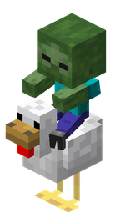
Notes:
Chicken Jockey

Slide 29
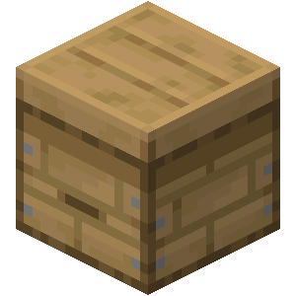
Notes:
beehive

Slide 30
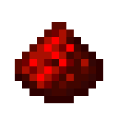
Notes:
Restone dust

Slide 31
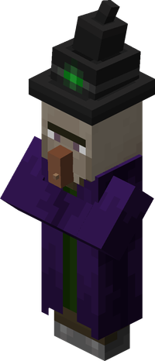
Notes:
witch

Slide 32

Notes:
Glass

Slide 33
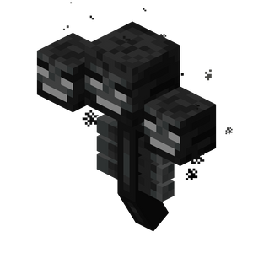
Notes:
wither

Slide 34
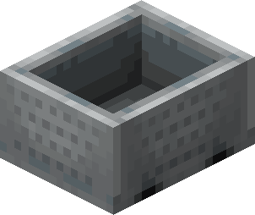
Notes:
minecart

Slide 35
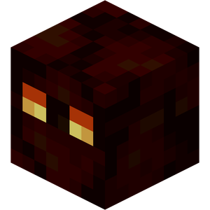
Notes:
Magma cube

Slide 36

Notes:
diamond

Slide 37
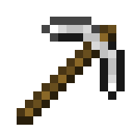
Notes:
pickaxe

Slide 38
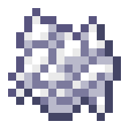
Notes:
Bone meal

Slide 39

Notes:
Lily of the valley

Slide 40
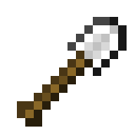
Notes:
shovel

Slide 41
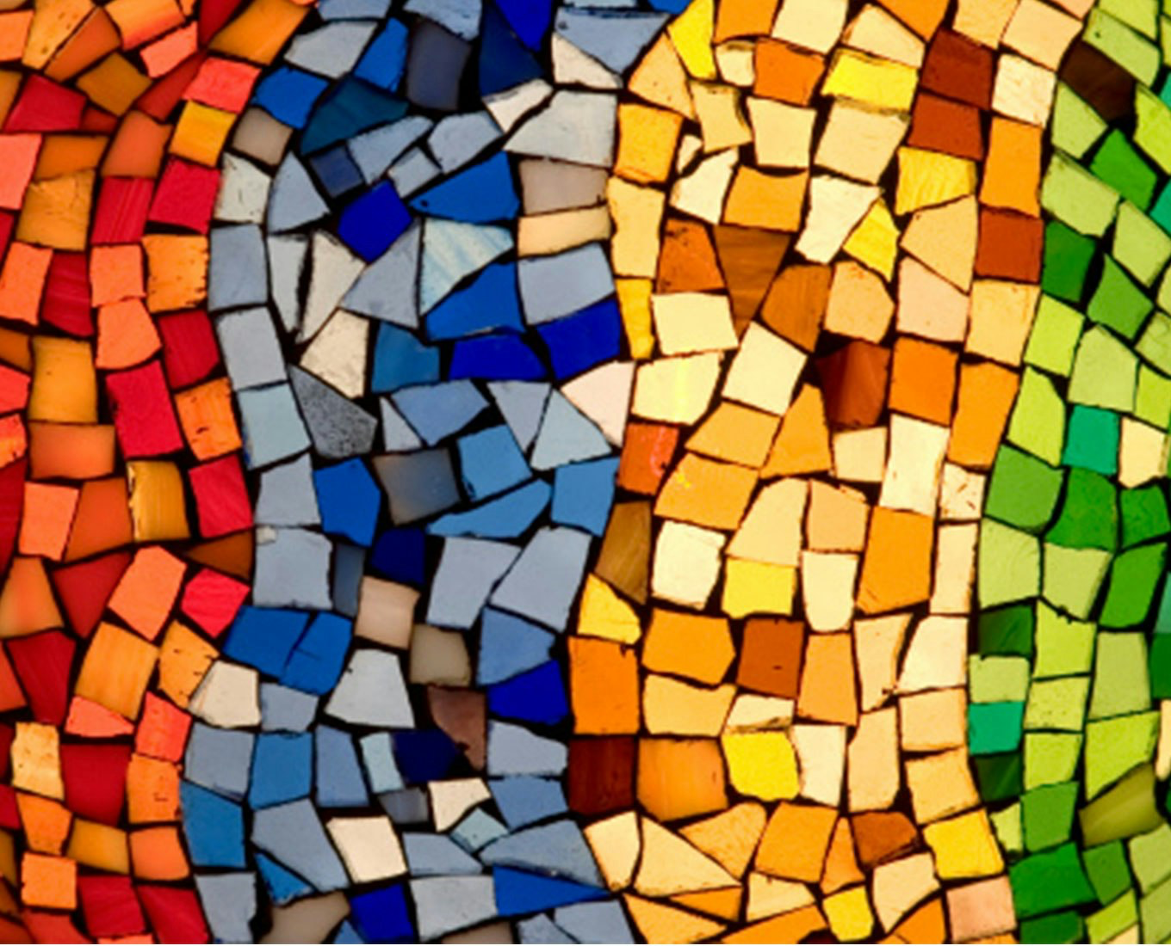
Notes:
mosaic

Slide 42
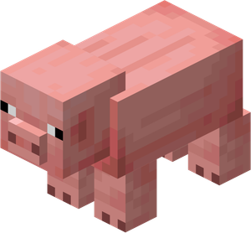
Notes:
pig

Slide 43

Notes:
Crafting table

Slide 44
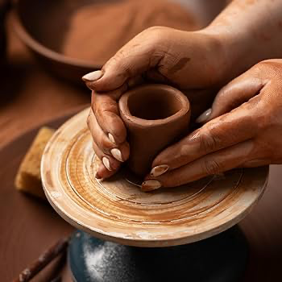
Notes:
pottery

Slide 45
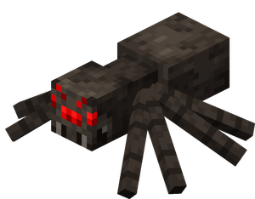
Notes:
spider

Slide 46
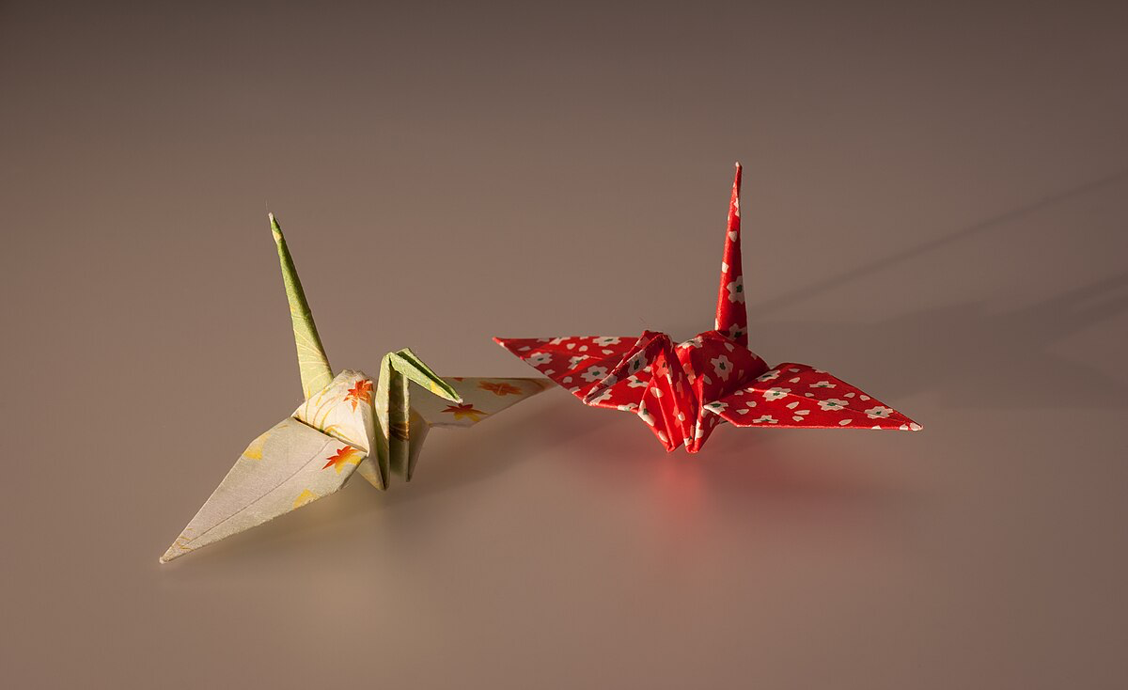
Notes:
origami

Slide 47
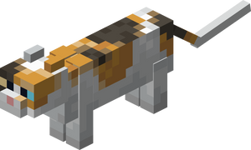
Notes:
cat

Slide 48
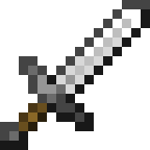
Notes:
sword

Slide 49
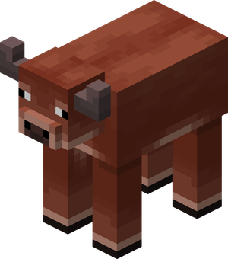
Notes:
cow

Slide 50
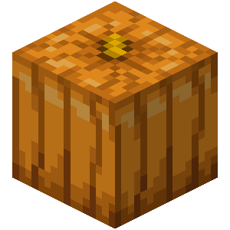
Notes:
pumpkin

